Slide 1

CAPSTONE PROJECT PROJECT Title:
BIG MART SALES PREDICATION USING MACHINE LEARNING WITH PYTHON
Presented By
Student Name: Bharath S Naik
College Name: CMR University
Department: Electronic & Communication Engineering
Email ID: bharath.naik@cmr.edu.in
AICTE Student ID: STU67a3932ee82741738773294

Slide 2
OUTLINE
Problem Statement
Proposed System/Solution
System Development Approach
Algorithm & Deployment
Result
Conclusion
Future Scope
References

Slide 3
Problem Statement
The company wants to predict the sales of its products to better understand customer preferences, optimize inventory management, and improve marketing strategies.
By predicting sales, the company can:
Identify top-selling products and underperforming ones.
Anticipate demand and avoid stockouts or overstock situations.
Develop targeted marketing campaigns for specific products or stores.
Optimize supply chain and resource allocation.
Identify factors influencing sales such as product visibility, pricing, and store location.
Overall, sales prediction helps the company make data-driven decisions and improve profitability

Slide 4
Proposed Solution
We propose a machine learning-based regression model to predict sales based on various features like product type, outlet size, location, MRP, visibility, and other relevant attributes.
The workflow of the system includes:
Data Collection – Historical sales data is gathered from different outlets.
Data Preprocessing – Handling missing values, encoding categorical variables, and feature scaling.
Exploratory Data Analysis (EDA) – Understanding patterns, trends, and correlations among features.
Model Building – Training different regression models.
Evaluation – Using performance metrics like RMSE (Root Mean Squared Error) and R² Score.
Deployment – The final model is deployed as a web or desktop application for business users to input product/outlet info and receive sales predictions.

Slide 5
System Approach
Programming Language: Python
Libraries Used:
Pandas & NumPy (Data handling)
Matplotlib & Seaborn (Data visualization)
Scikit-learn (Machine Learning algorithms and evaluation)
Environment: Jupyter Notebook / Google Colab
Model Deployment (Optional): Streamlit / Flask for web-based dashboard

Slide 6
Algorithm & Deployment
Algorithm Selection: XGBoost Regressor selected for its ability to model complex, non-linear relationships and reduce overfitting through ensemble learning.
Data Input: Features like item details and outlet characteristics were preprocessed, with missing values handled and categorical data encoded.
Training Process: Model trained on 80% of the data with cross-validation and hyperparameter tuning using GridSearchCV to optimize accuracy.
Prediction Process: Predicts future sales from input features in real time or batches using the trained model.
Deployment: Integrated into a user-friendly Streamlit app, with optional cloud deployment on platforms like Heroku or AWS for broader access.

Slide 7
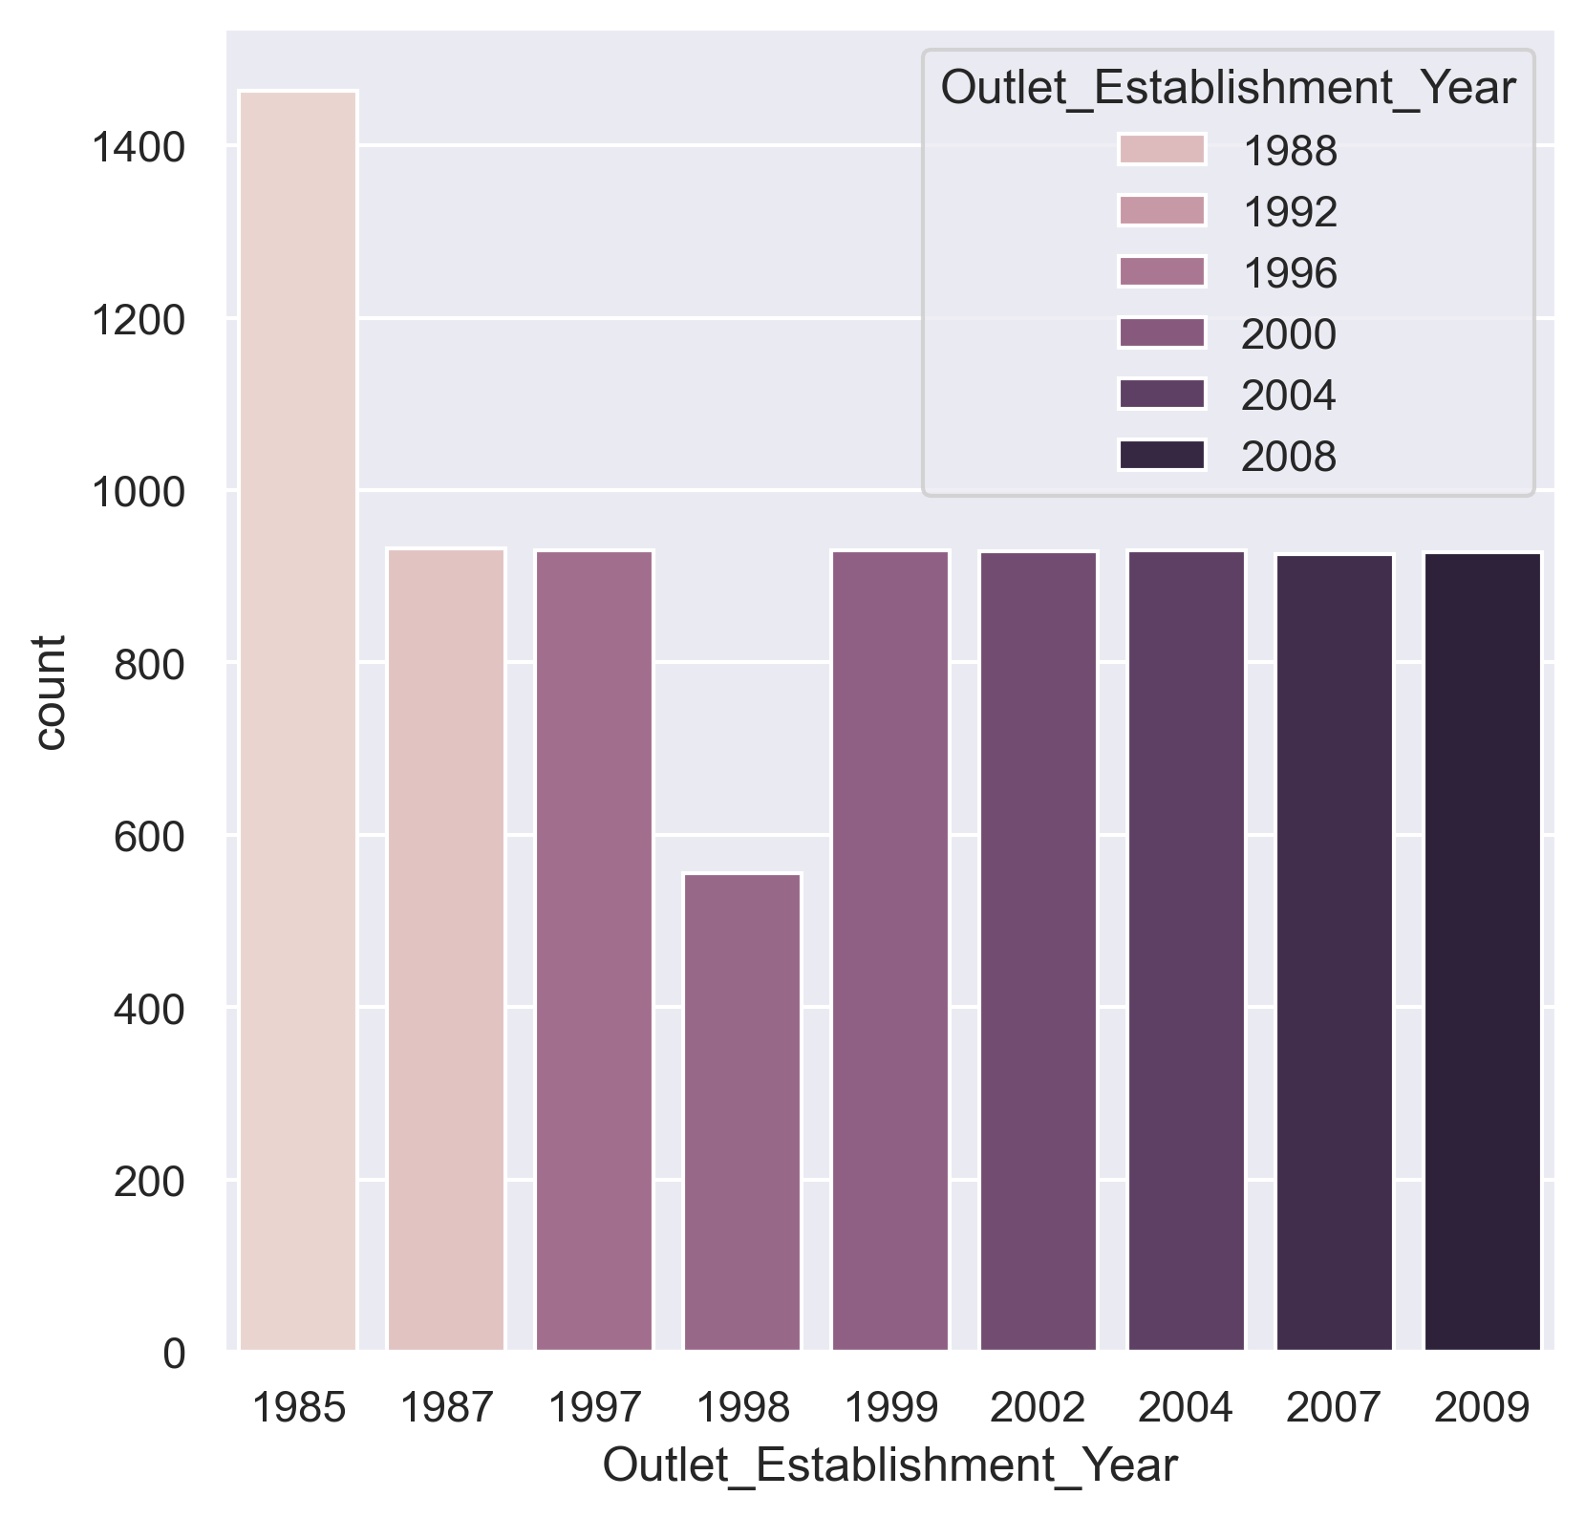
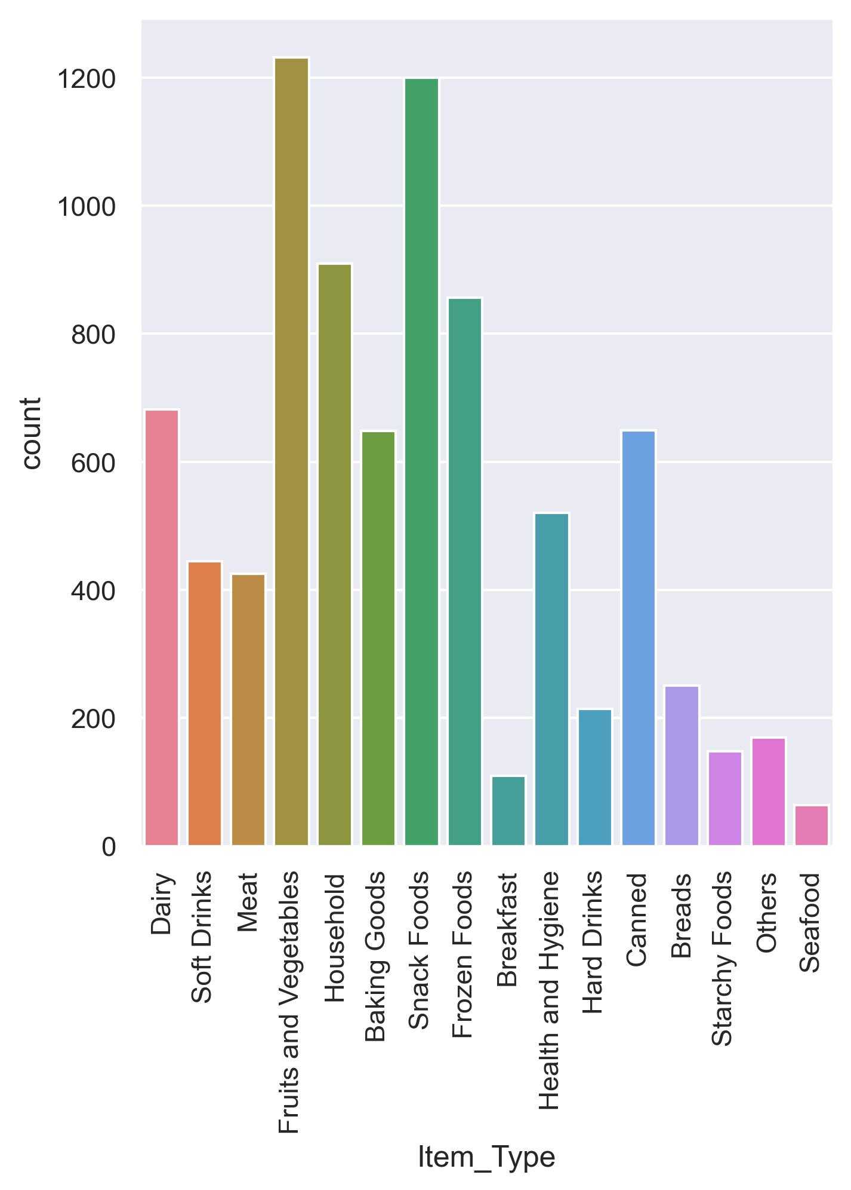
Result
RMSE : 1154.30
R² score : 0.593
ALGORITHM : XGBOOST REGRESSOR
FEATURE IMPORTANCE

Slide 8
Conclusion
Using machine learning, we developed a sales prediction model that enables Big Mart to make data-driven decisions regarding product stocking, promotional strategies, and outlet performance. By analyzing historical sales data and relevant product-outlet features, the model reduces reliance on guesswork and enhances operational efficiency. This predictive system offers valuable insights that help management optimize inventory, target high-performing products, and improve overall business planning

Slide 9
Future scope
Integration with real-time sales data and inventory systems.
Incorporating external factors like seasonality, holidays, or competitor activity.
Model retraining on a regular basis for continuous improvement.
Adding customer demographics for more personalized prediction.
Creating dashboards for easy visualization and usage by non-technical stakeholders.

Slide 10
References
Scikit-learn Documentation
Pandas Documentation
Kaggle - Big Mart Sales Dataset
Hands-On Machine Learning with Scikit-Learn, Keras, and TensorFlow – Aurelien Geron
GitHub Link: https://github.com/bharathsnaik-code/BIG-MART-SALES-PREDICTION-USING-MACHINE-LEARING-WITH-PYTHON

Slide 11
Thank you

